Slide 1

Blockchain FOR VEHICLE REGITRATION
Final Year Project
Session 2017-2021
Project supervisor
Miss. Tahira saddaf
Department of Computer Sciences

Slide 2
Group Members
SHAHZAIB HASSAN
SP17-BCS-034
SULEMAN KHAN
SP17-BCS-043
MUHAMMAD ABUBAKAR
SP17-BCS-050

Slide 3
OUTLINES
Introduction
Problem statement
Objectives
Methodology
Existing apps
Tools and technology
Benefits
Diagrams
References

Slide 4
INTRODUCTION WHAT IS BLOCKCHIAN?
When we say the word “blockchain” in this context we are talking about the digital information (the block) stores in a public database (the chain). In Blockchain there are three parts.

Slide 5
INTRODUCTION PARTS OF BLOCKCHAIN
THERE ARE THREE PARTS OF BLOCKCHAIN TECHNOLOGY THAT IS ESSENTIAL TO BUILD A BLOCKCHAIN TECHNOLOGY
Hash (WHICH IS THE ENCRPTED FORM OF DATA)
PREVIOUS HASH (HASH VALUE OF THE PREVIOUS BLOCK)
DATA (WHICH IS THE DIGITAL INFORMATION THAT IS STORED IN THE BLOCK)

Slide 6
Problem Statement
A car registration system, as implemented by most government entities around the world, is usually a centralized information system. This information system handles every information related to car registration and is managed by a national registry entity, although other governmental and non-governmental entities have access to services handling car registration information. Government entities responsible for controlling motorized vehicles can interact with the system to issue and cancel registration plates and to change the Social characteristics of a vehicle.

Slide 7
Objectives
We have vision to step-in and try our best to do same-thing or even-better to reduce complexity of the work. Our main goal is to take modern technology into surroundings.

Slide 8
Methods to achieve our Goals
To achieve our goal (building BLOCKCHAIN FOR VEHICLE REGISTRATION) we will work together. And algorithms for implementing blockchain will be done along side.

Slide 9
Existing applications
Blockchain applications go far beyond cryptocurrency and bitcoin. With its ability to create more transparency and fairness while also saving businesses time and money.
PROMINENT BLOCKCHAIN APPLICATIONS TO KNOW
Secure sharing of medical data
Cross-border payments
Personal identity security
Cryptocurrency exchange
And many more…

Slide 10
Modern Tools and Techniques
We will use Blockchain as a Service in our website.
Following are the tools that will be used in this project.
Visual Studio Code (HTML & CSS)
MS Office (Documentation)
Remix (Ethereum’s Solidity)
Ganache (Provides Blockchain Simulation)
Adobe (For design and diagram)

Slide 11
Benefits
The blockchain technology allows for verification without having to be dependent on third-parties.
The data structure in a blockchain is append-only.
It uses protected cryptography to secure the data ledgers.
The data is placed on the different places (nodes) which does not allow data to be lost or destroyed.

Slide 12
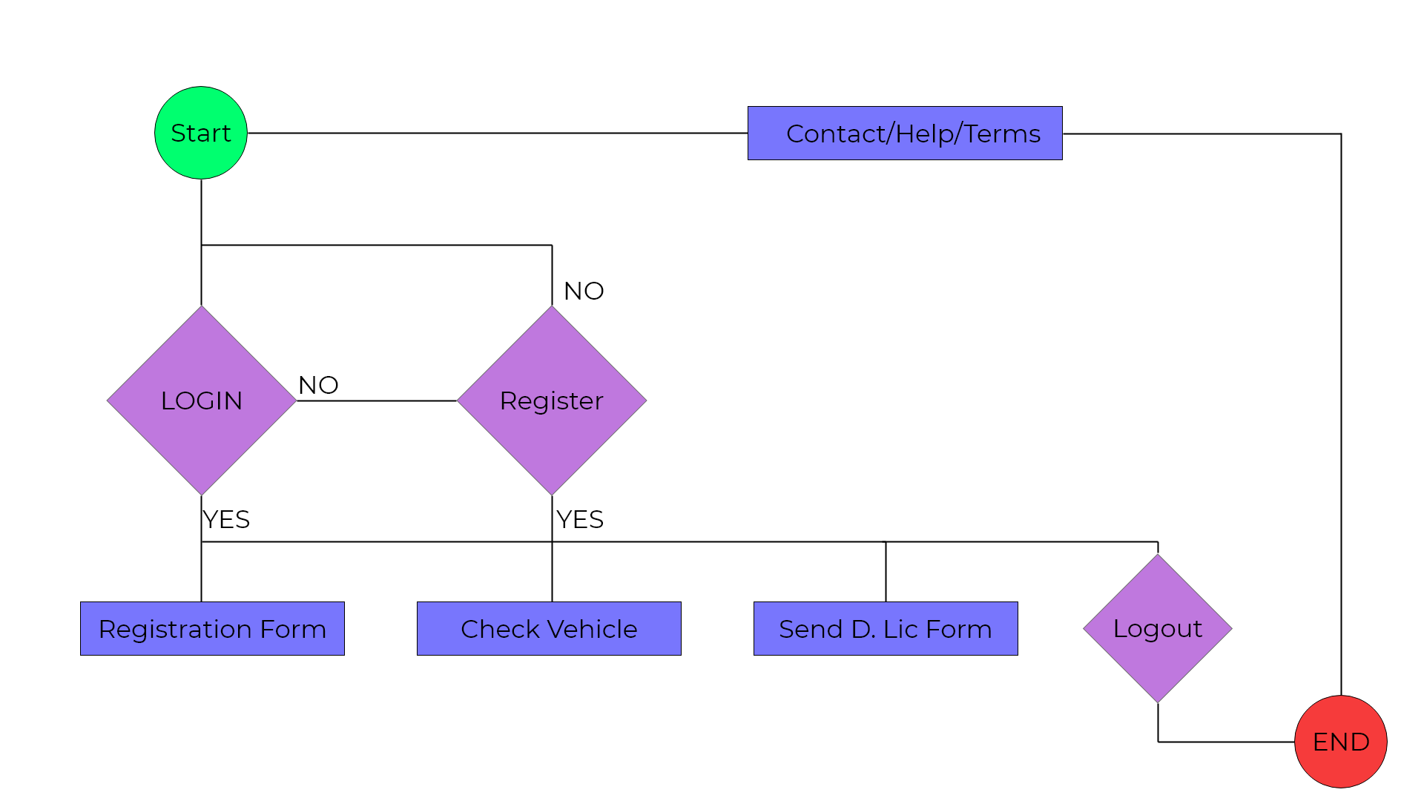
Diagrams
Activity Diagrams

Slide 13
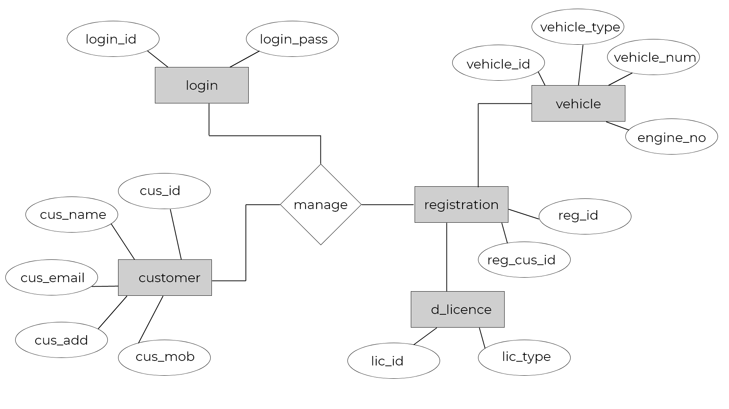
Diagrams
ERD

Slide 14
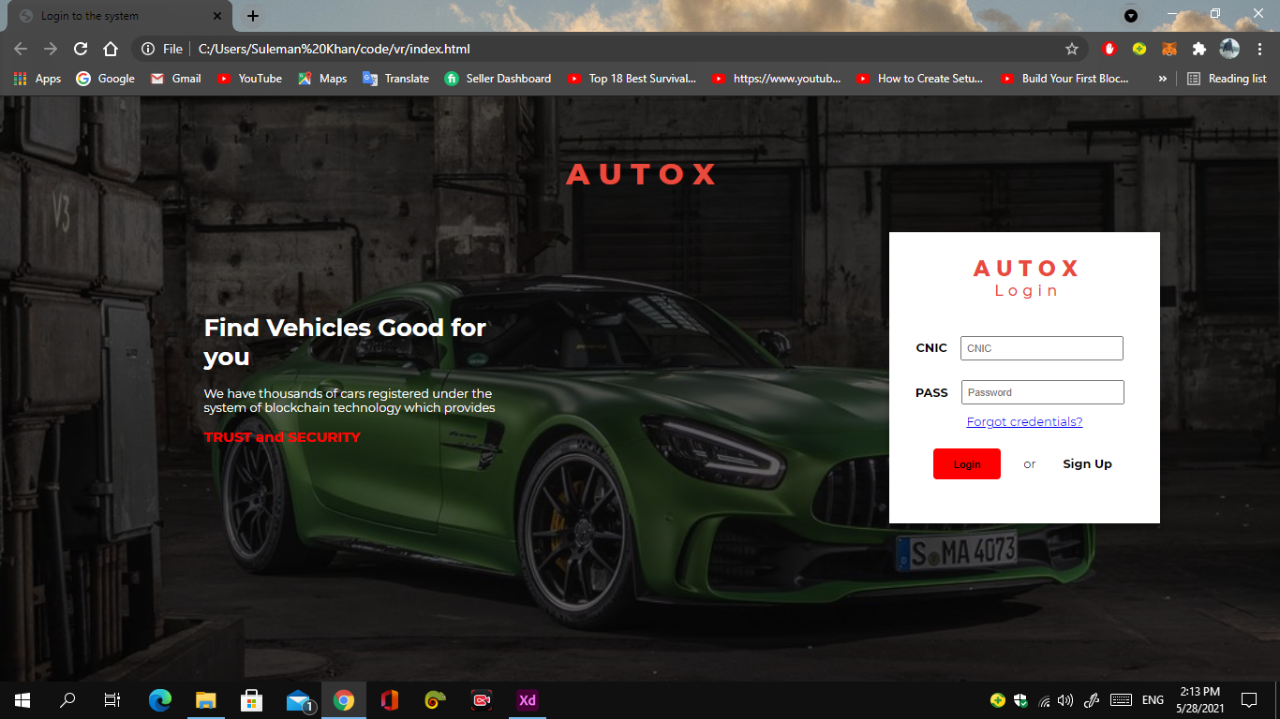
Diagrams
Login Page

Slide 15
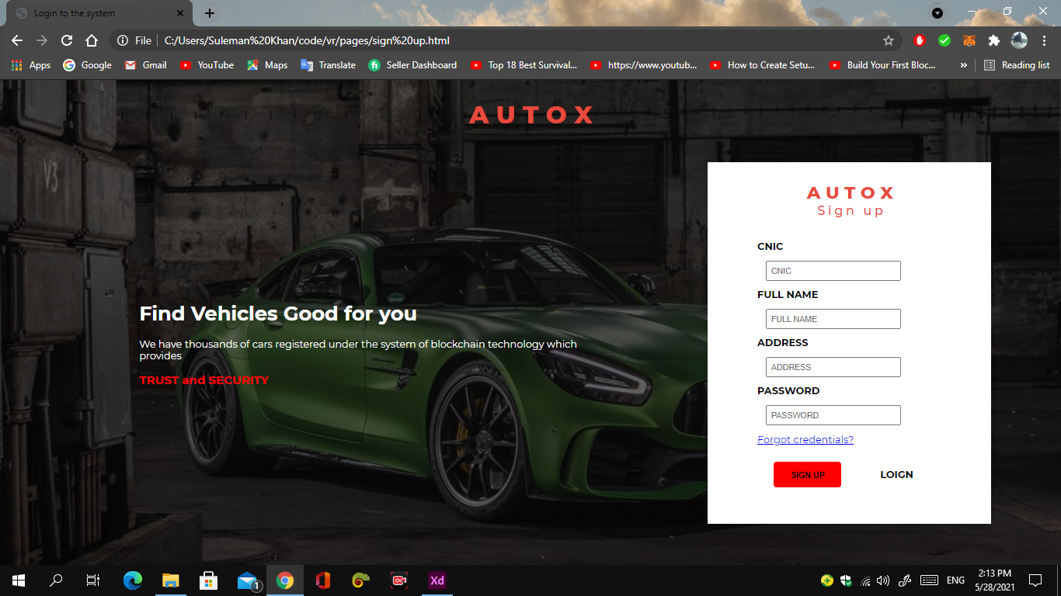
Diagrams
SIGNUP PAGE

Slide 16
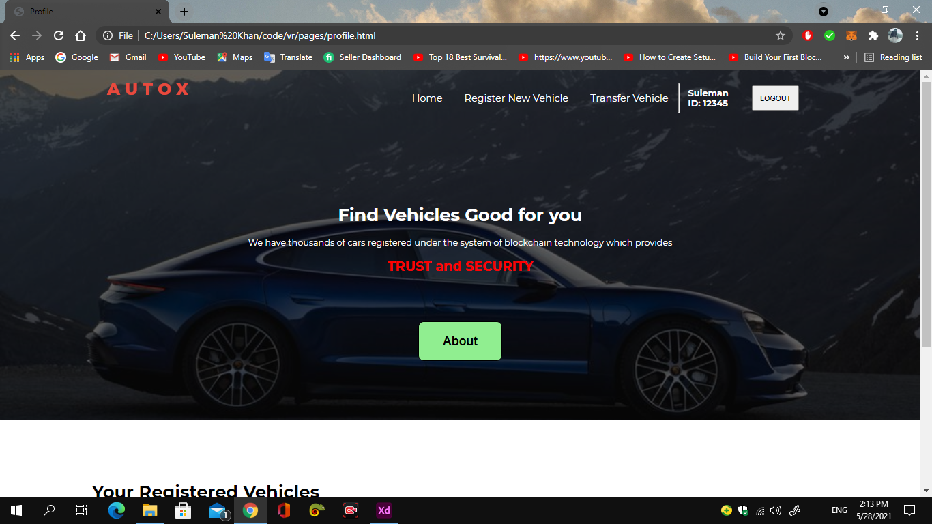
Diagrams
User profile

Slide 17
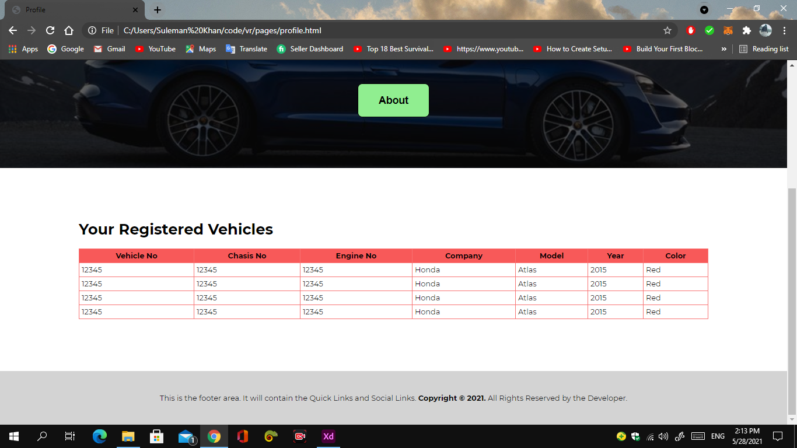
Diagrams
User Registered vehicles

Slide 18
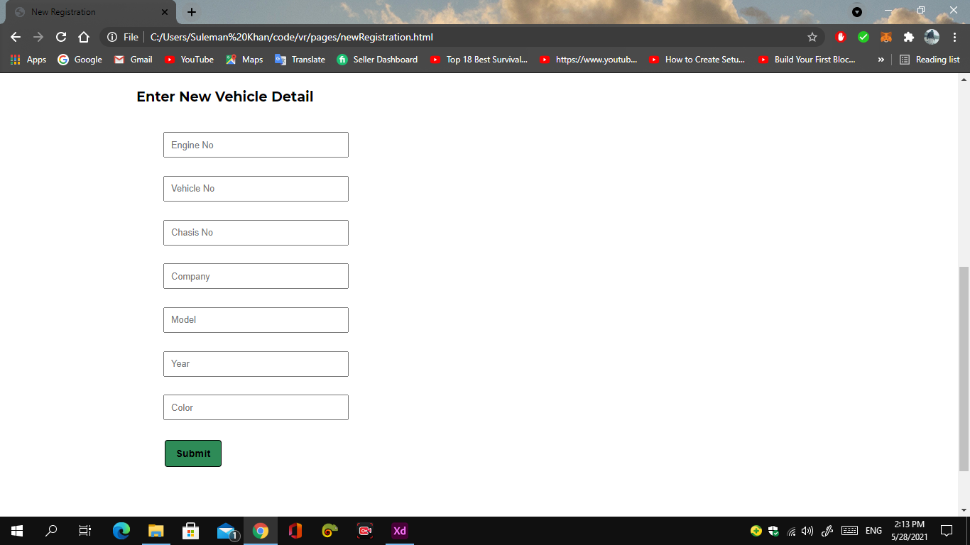
Diagrams
User new Registration form

Slide 19
References
What is blockchain?
https://www.google.com/search?q=blockchain&oq=blockchain&aqs=chrome.0.0j69i60l2j0l4.1791j0j9&sourceid=chrome&ie=UTF-8
Research Paper.
https://www.researchgate.net/publication/332977375_Blockchain_Technologies_in_E-commerce_Social_Shopping_and_Loyalty_Program_Applications

